Slide 1
Intelligent Agents

Slide 2
AGENTS
What is an Agent?
An agent can be anything that perceive its environment through sensors and act upon that environment through actuators.
An Agent runs in the cycle of perceiving, thinking, and acting. An agent can be:
Human-Agent: A human agent has eyes, ears, and other organs which work for sensors and hand, legs, vocal tract work for actuators.
Robotic Agent: A robotic agent can have cameras, infrared range finder, NLP for sensors and various motors for actuators.
Software Agent: Software agent can have keystrokes, file contents as sensory input and act on those inputs and display output on the screen.
Hence the world around us is full of agents.

Slide 3
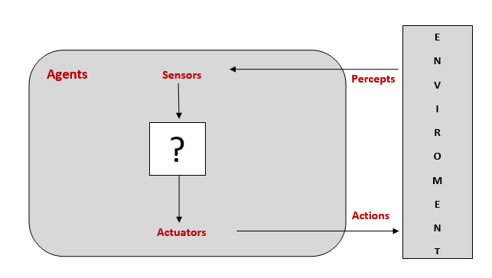
Sensor: Sensor is a device which detects the change in the environment and sends the information to other electronic devices. An agent observes its environment through sensors.
Actuators: Actuators are the component that act upon the environment. The actuators are only responsible for moving and controlling a system. An actuator can be an electric motor, gears, rails, etc.
Agents interact with environments through sensors and actuators.

Slide 4
AGENTS AND ENVIRONMENTS
The term percept to refer to the agent’s perceptual inputs at any given instant
An agent’s percept sequence is the complete history of everything the agent has ever perceived.
In general, an agent’s choice of action at any given instant can depend on the entire percept sequence observed to date, but not on anything it hasn’t perceived. B
An agent’s behavior is described by the agent function that maps any given percept sequence to an action.
Given an agent to experiment with, we can construct a table by trying out all possible percept sequences and recording which actions the agent does in response.
The table is an external characterization of the agent.
Internally, the agent function for an artificial agent will be implemented by an agent program.
It is important to keep these two ideas distinct.
The agent function is an abstract mathematical description; the agent program is a concrete implementation, running within some physical system.

Slide 5
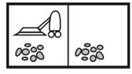
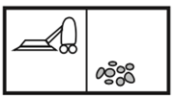
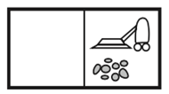
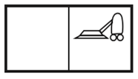
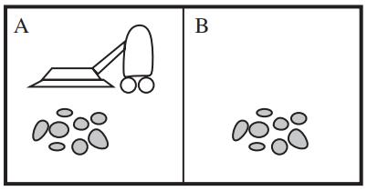
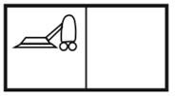
Simple example—the vacuum-cleaner world
This particular world has just two locations: squares A and B. The vacuum agent perceives which square it is in and whether there is dirt in the square. It can choose to move left, move right, suck up the dirt, or do nothing.
One very simple agent function is the following: if the current square is dirty, then suck; otherwise, move to the other square

Slide 6
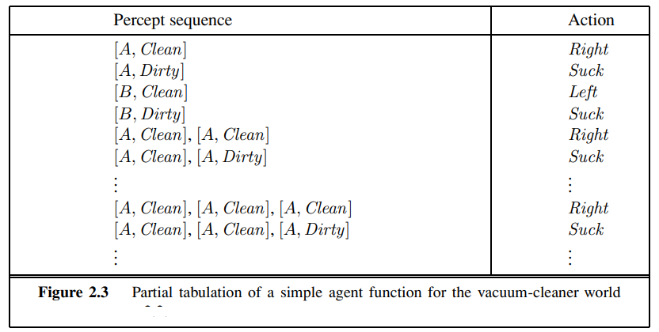

Slide 7
GOOD BEHAVIOR: THE CONCEPT OF RATIONALITY
A rational agent is one that does the right thing that is the right actions will cause the agent to be most successful in the environment.
A rational agent is one that does the right ie every entry in the table for the agent function is filled out correctly.
When an agent is put down in an environment, it generates a sequence of actions according to the percepts it receives.
This sequence of actions causes the environment to go through a sequence of states. If the sequence is desirable, then the agent has performed well.
This notion of desirability is captured by a performance measure that evaluates any given sequence of environment states.
Performance measure
A performance measures embodies the criterion for success of an agent‘s behavior.
There is no one fixed performance measure for all tasks and agents; typically, a designer will devise one appropriate to the circumstances.
As a general rule, it is better to design performance measures according to what one actually wants in the environment, rather than according to how one thinks the agent should behave.

Slide 8
Rationality
What is rational at any given time depends on four things:
• The performance measure that defines the criterion of success.
• The agent’s prior knowledge of the environment.
• The actions that the agent can perform.
• The agent’s percept sequence to date.
Rational agent (ideal rational agent)
Def: “For each possible percept sequence, a rational agent should select an action that is expected to maximize its performance measure, given the evidence provided by the percept sequence and whatever built-in knowledge the agent has”
Consider the simple vacuum-cleaner agent that cleans a square if it is dirty and moves to the other square if not. Is this a rational agent?
That depends! First, we need to say what the performance measure is, what is known about the environment, and what sensors and actuators the agent has.

Slide 9
•
Let us assume the following.
The performance measure awards one point for each clean square at each time step, over a “lifetime” of 1000 time steps.
• The “geography” of the environment is known a priori but the dirt distribution and the initial location of the agent are not.
Clean squares stay clean and sucking cleans the current square.
• The only available actions are Left, Right, and Suck.
• The agent correctly perceives its location and whether that location contains dirt.
We claim that under these circumstances the agent is indeed rational., it’s expected performance is at least as high as any other agent’s.
The same agent would be irrational under different circumstances. For example, once all the dirt is cleaned up, the agent will oscillate needlessly back and forth; if the performance measure includes a penalty of one point for each movement left or right, the agent will fare poorly.

Slide 10
Omniscience, learning, and autonomy
An omniscient agent knows the actual outcome of its actions and can act accordingly; but omniscience is impossible in reality. “Idiot attempts to cross street”
Rationality maximizes expected performance, while perfection maximizes actual performance.
A rational agent has to gather information, and also to learn as much as possible from what it perceives.
The agent’s initial configuration could reflect some prior knowledge of the environment, but as the agent gains experience this may be modified and augmented.
There are extreme cases in which the environment is completely known a priori. In such cases, the agent need not perceive or learn; it simply acts correctly.

Slide 11
Rational agent
A rational agent should be autonomous—it should learn what it can to compensate for partial or incorrect prior knowledge.
For example, a vacuum-cleaning agent that learns to foresee where and when additional dirt will appear will do better than one that does not.
when the agent has had little or no experience, it would have to act randomly unless the designer gave some assistance
it would be reasonable to provide an artificial intelligent agent with some initial knowledge as well as an ability to learn. After sufficient experience of its environment, the behavior of a rational agent can become effectively independent of its prior knowledge.
Hence, the incorporation of learning allows one to design a single rational agent that will succeed in a vast variety of environments

Slide 12
THE NATURE OF ENVIRONMENTS
Task Environment : the “problems” to which rational agents are the “solutions.” Any task environment is characterized on the basis of PEAS.
Performance – What is the performance characteristic which would either make the agent successful or not. For example, as per the previous example clean floor, optimal energy consumption might be performance measures.
Environment – Physical characteristics and constraints expected. For example, wood floors, furniture in the way etc.
Actuators – The physical or logical constructs which would take action. For example for the vacuum cleaner, these are the suction pumps
Sensors – Again physical or logical constructs which would sense the environment. Example, cameras and dirt sensors.

Slide 13
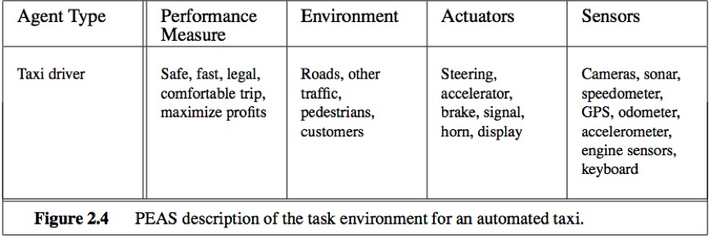
Specifying the task environment
The PEAS description for an automated taxi driver. .

Slide 14
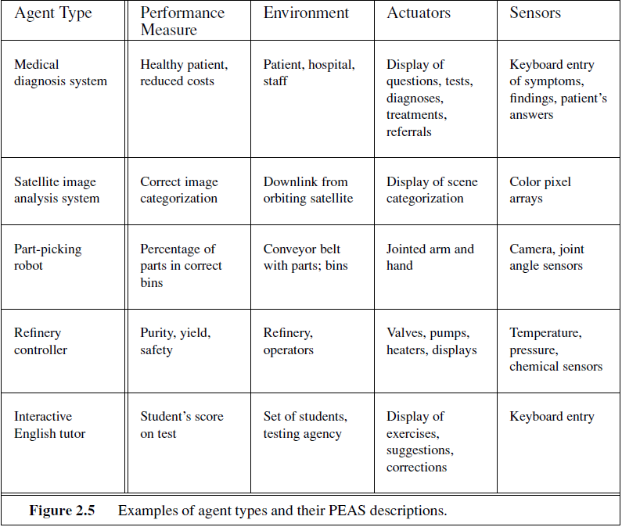

Slide 15
Properties of task environments
An environment in artificial intelligence is the surrounding of the agent. The agent takes input from the environment through sensors and delivers the output to the environment through actuators.
Task Environments:
Fully Observable vs Partially Observable
Deterministic vs Stochastic
Competitive vs Collaborative
Single-agent vs Multi-agent
Static vs Dynamic
Discrete vs Continuous
Episodic vs sequential
Known vs Unknown
Accessible vs Inaccessible

Slide 16
Fully observable vs. partially observable
If an agent’s sensors give it access to the complete state of the environment at each point in time, then the task environment is fully observable.
Fully observable environments are convenient because the agent need not maintain any internal state to keep track of the world
An environment might be partially observable because of noisy and inaccurate sensors or because parts of the state are simply missing from the sensor data
If the agent has no sensors at all then the environment is unobservable.
Examples:
Chess – the board is fully observable, and so are the opponent’s moves.
Driving – the environment is partially observable because what’s around the corner is not known.

Slide 17
Competitive vs Cooperative
An agent is said to be in a competitive environment when it competes against another agent to optimize the output.
An agent is said to be in a collaborative environment when multiple agents cooperate to produce the desired output.
The game of chess is competitive as the agents compete with each other to win the game which is the output.
When multiple self-driving cars are found on the roads, they cooperate with each other to avoid collisions and reach their destination which is the output desired.

Slide 18
Deterministic vs. stochastic
If the next state of the environment is completely determined by the current state and the action executed by the agent, then the environment is deterministic; otherwise, it is stochastic.
an agent need not worry about uncertainty in a fully observable, deterministic environment.
If the environment is partially observable then it could appear to be stochastic. Taxi driving is clearly stochastic in this sense, because one can never predict the behavior of traffic exactly; moreover, one’s tires blow out and one’s engine seizes up without warning
The vacuum world as we described it is deterministic, but variations can include stochastic elements such as randomly appearing dirt and an unreliable suction mechanism
Examples:
Chess – there would be only a few possible moves for a coin at the current state and these moves can be determined.
Self-Driving Cars- the actions of a self-driving car are not unique, it varies time to time.

Slide 19
Single agent vs. Multiagent
An environment consisting of only one agent is said to be a single-agent environment.
An environment involving more than one agent is a multi-agent environment.
An agent solving a crossword puzzle by itself is clearly in a single-agent environment, whereas an agent playing chess is in a two agent environment.
Taxi-driving is a cooperative multiagent environment. It is also partially competitive because, only one car can occupy a parking space.

Slide 20
Episodic vs. sequential
In an Episodic task environment, each of the agent’s actions is divided into atomic incidents or episodes.
There is no dependency between current and previous episodes.
In each episode, an agent receives input from the environment and then performs the corresponding action.
In a Sequential environment, the previous decisions can affect all future decisions.
The next action of the agent depends on what action he has taken previously and what action he is supposed to take in the future.
Chess and taxi driving are sequential: in both cases, short-term actions can have long-term consequences.
Episodic environments are much simpler than sequential environments because the agent does not need to think ahead.

Slide 21
Static vs. dynamic
If the environment can change while an agent is deliberating, then the environment is dynamic for that agent.
An environment with no change in its state is called a static environment.
Static environments are easy to deal with because the agent neither need to look at the world while it is deciding on an action, nor need it worry about the passage of time.
Dynamic environments continuously ask the agent what it wants to do; if it hasn’t decided yet, that counts as deciding to do nothing.
If the environment itself does not change with the passage of time but the agent’s performance score does, then we say the environment is semidynamic.

Slide 22
Discrete vs. continuous
The discrete/continuous distinction applies to the state of the environment, to the way time is handled, and to the percepts and actions of the agent
If an environment consists of a finite number of actions that can be deliberated in the environment to obtain the output, it is said to be a discrete environment.
The chess environment has a finite number of distinct states. Chess also has a discrete set of percepts and actions.
Taxi driving is a continuous-state and continuous-time problem: the speed and location of the taxi and of the other vehicles sweep through a range of continuous values and do so smoothly over time.
Taxi-driving actions are also continuous (steering angles, etc.).

Slide 23
Known vs Unknown
Known and unknown are not actually a feature of an environment, but it is an agent's state of knowledge to perform an action.
In a known environment, the output for all probable actions is given.
In case of unknown environment, for an agent to make a decision, it has to gain knowledge about how the environment works.
It is quite possible that a known environment to be partially observable and an Unknown environment to be fully observable.

Slide 24
Accessible vs Inaccessible
If an agent can obtain complete and accurate information about the state's environment, then such an environment is called an Accessible environment else it is called inaccessible.
An empty room whose state can be defined by its temperature is an example of an accessible environment.
Information about an event on earth is an example of Inaccessible environment.

Slide 25
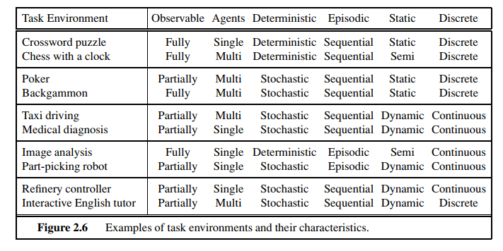

Slide 26
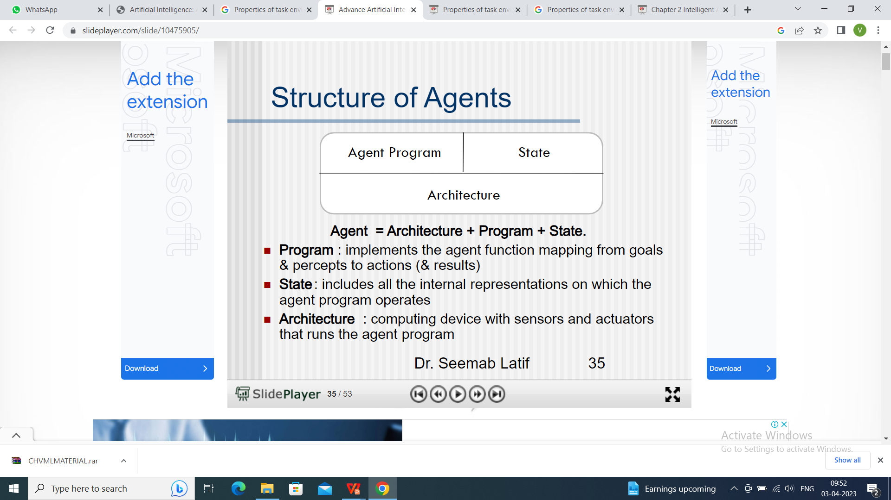

Slide 27
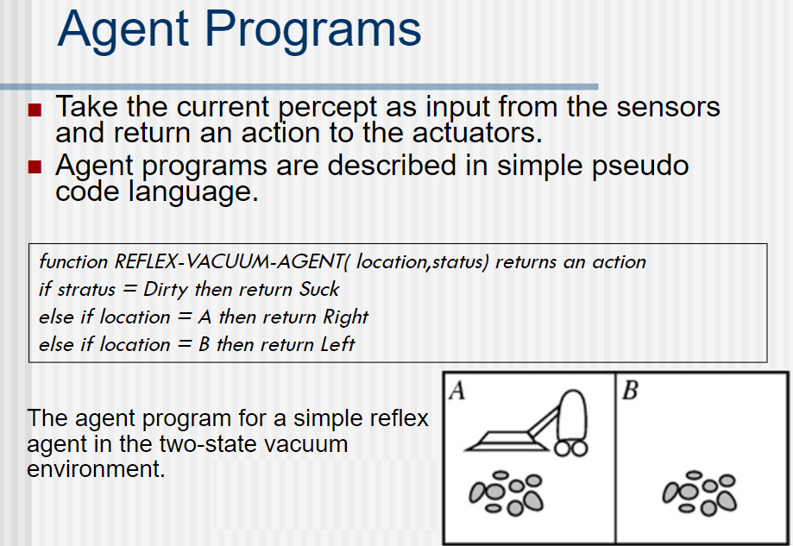

Slide 28
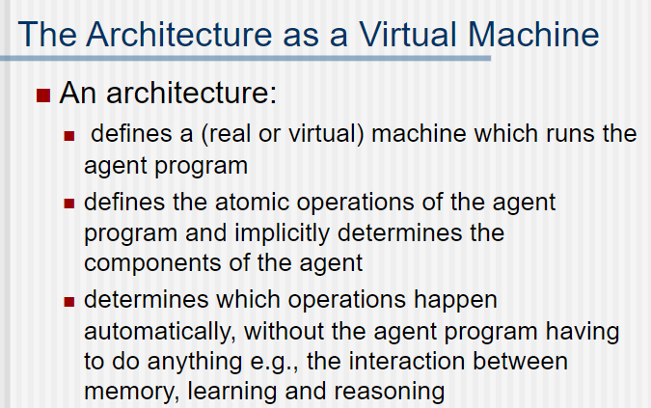

Slide 29
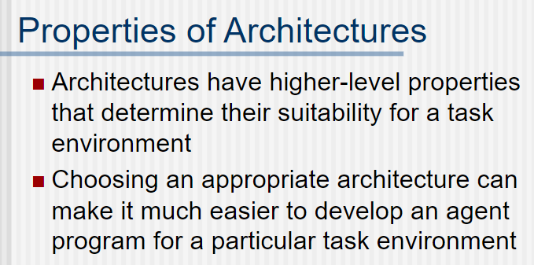

Slide 30
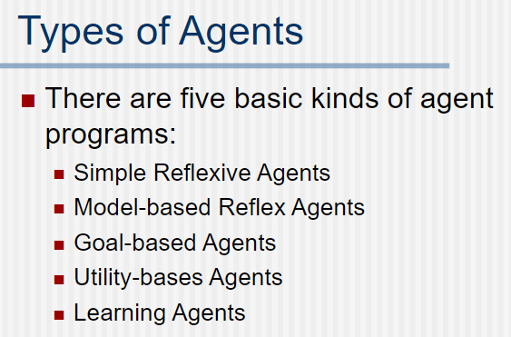

Slide 31
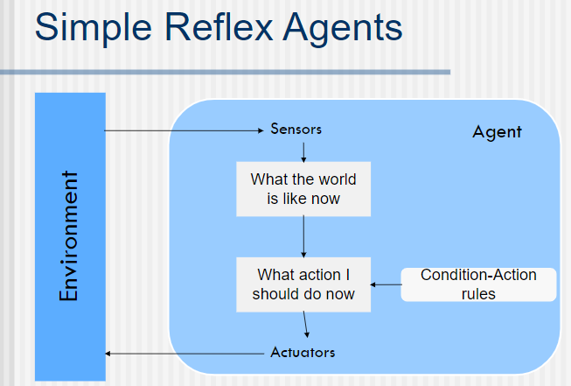
These agents select actions on the basis of the current percept, ignoring the rest of the percept history.

Slide 32
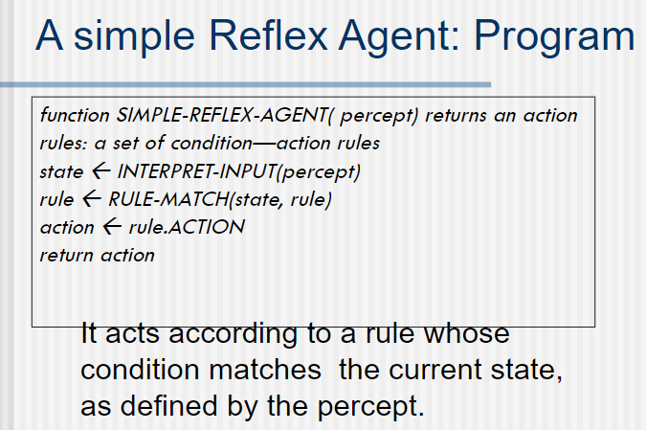

Slide 33
These agents only succeed in the fully observable environment.
The Simple reflex agent does not consider any part of percepts history during their decision and action process.
The Simple reflex agent works on Condition-action rule, which means it maps the current state to action. Such as a Room Cleaner agent, it works only if there is dirt in the room.
Advantage is simple
Problems for the simple reflex agent design approach:
They have very limited intelligence
They do not have knowledge of non-perceptual parts of the current state
Mostly too big to generate and to store.
Not adaptive to changes in the environment.

Slide 34
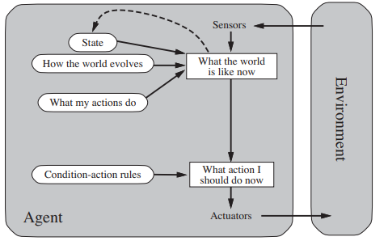
Model-based reflex agent
Model – based reflex agents maintain internal state to track aspects of the world that are not evident in the current percept. The most effective way to handle partial observability is for the agent to keep track of the part of the world it cant see now. The agent should maintain some sort of internal state that depends on the percept history and thereby reflects at least some of the un observed aspects of the current state.

Slide 35
Updating this internal site information as time goes by requires two kinds of knowledge to be encoded in the agent program.
First, we need some information about how the world evolves independently of the agent
Second, we need some information about how the agents own actions affect the world
This knowledge about “how the world works” – whether implemented in simple Boolean circuits or in complete scientific theories – is called a model of the world. An agent that uses such a model is called a model – based agent.

Slide 36
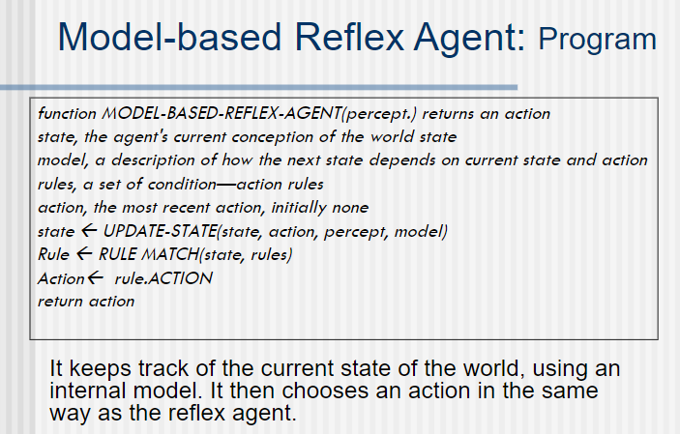

Slide 37
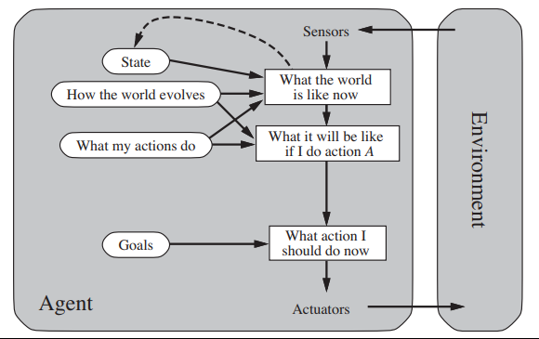
Goal based Agent
Knowing about the current state of the environment is not always enough to decide what to do

Slide 38
Goal based Agent
Knowing about the current state of the environment is not always enough to decide what to do.
Sometimes, goal – based action selection is straight forward, when goal satisfaction results immediately from a single action. Sometimes it will be more tricky, when the agent has to consider long sequences of twists an turns to find a way to achieve the goal
It involves consideration of the future—both “What will happen if I do such-and-such?” and “Will that make me happy?”
Although the goal-based agent appears less efficient, it is more flexible because the knowledge that supports its decisions is represented explicitly and can be modified.

Slide 39
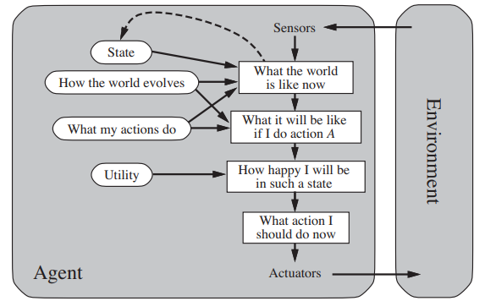
Utility based Agents
Goals alone are not really enough to generate high quality behaviour in most environments

Slide 40
performance measure assigns a score to any given sequence of environment states, so it can easily distinguish between more and less desirable ways.
If the internal utility function and the external performance measure are in agreement, then an agent that chooses actions to maximize its utility will be rational according to the external performance measure.
utility-based agent has many advantages in terms of flexibility and learning.
when there are conflicting goals, only some of which can be achieved (for example, speed and safety), the utility function specifies the appropriate tradeoff.
Second, when there are several goals that the agent can aim for, none of which can be achieved with certainty, utility provides a way in which the likelihood of success can be weighed against the importance of the goals.

Slide 41
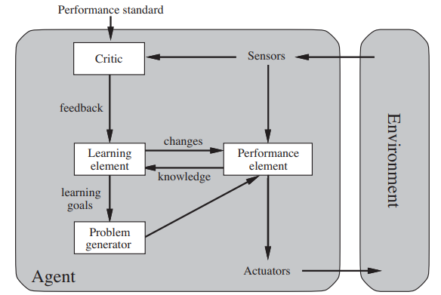
Learning Agent
Learning agent can be divided into 4 conceptual components:
1.Learning element : which is responsible for making improvements
2.Performance element : which is responsible for selecting external actions.
3.critic: how the agent is doing and determine how the performance element should be modified to do better in the future.
4.Problem generator : responsible for suggesting actions that will lead to new and informative experiences.

Slide 42
proposes is to build learning machines and then to teach them.
it allows the agent to operate in initially unknown environments and to become more competent than its initial knowledge alone might allow. In many areas of AI, this is now the preferred method for creating state-of-the-art systems.
The design of the learning element depends very much on the design of the performance element.
Learning in intelligent agents can be summarized as a process of modification of each component of the agent to bring the components into closer agreement with the available feedback information, thereby improving the overall performance of the agent.

Slide 43
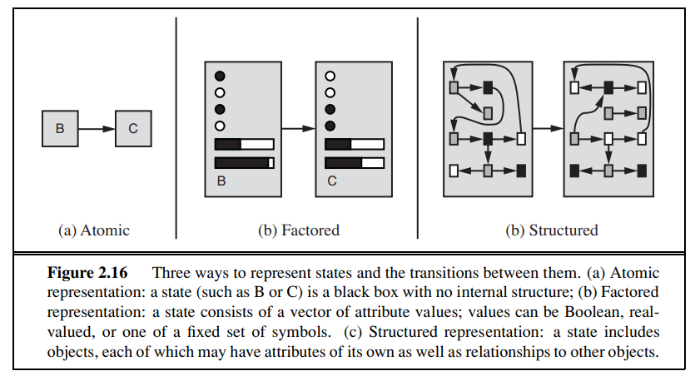
How the components of agent programs work

Slide 44
In an atomic representation each state of the world is indivisible—it has no internal ATOMIC REPRESENTATION structure
A factored representation splits up each state into a fixed set of FACTORED REPRESENTATION VARIABLE variables or attributes, each of which can have a value. (common attributes, represent uncertainty)
For many purposes, we need to understand the world as having things in it that are related to each other, not just variables with values.

